Slide 1

Department of CSE
Course: AI & ML
Course code: 24AD2001A
Topic:
Generalized Method of Moments (GMM)
Session – 31

Slide 2



AIM OF THE SESSION
The aim of this session is to introduce learners to Gaussian Processes as a probabilistic, non-parametric modeling approach for regression and classification, with emphasis on understanding kernels, uncertainty quantification, model calibration, and confidence estimation for reliable decision-making in machine learning applications.
INSTRUCTIONAL OBJECTIVES
This session is designed to:
1. Understand the concepts and mathematical foundations of hard and probabilistic clustering.
2. Learn how to partition data into clusters using C-means and GMM.
LEARNING OUTCOMES
At the end of this session, you should be able to:
1. Understand the concept of clustering and distinguish between hard (C-means/k-means) and probabilistic clustering (GMM).
2. Explain the mathematical formulation of C-means and GMM, including the objective functions and EM algorithm steps.

Slide 3
Objectives
1. Define clustering and its types, including hard (C-means/k-means) and soft (GMM) clustering.
2. Describe the mathematical foundation of C-means clustering and Gaussian Mixture Models.
3.Explain the Expectation-Maximization (EM) algorithm for parameter estimation in GMM.

Slide 4
Generalized Method of Moments (GMM)
The Generalized Method of Moments (GMM) is a method used to estimate the parameters such as slope or intercept in models when traditional methods do not work well. It is useful when the data does not follow the usual assumptions, when there are issues with the data or when the independent variable is related to the error term. It is an extension of the Method of Moments (MM).
A Gaussian mixture model is a soft clustering technique used in unsupervised learning to determine the probability that a given data point belongs to a cluster. It’s composed of several Gaussians, each identified by k ∈ {1,…, K}, where K is the number of clusters in a data set.

Slide 5
What Is a Gaussian Mixture Model?
A Gaussian mixture is a function that is composed of several Gaussians, each identified by k ∈ {1,…, K}, where K is the number of clusters of our data set. Each Gaussian k in the mixture is comprised of the following parameters:
A mean μ that defines its center.
A covariance Σ that defines its width. This would be equivalent to the dimensions of an ellipsoid in a multivariate scenario.
A mixing probability π that defines how big or small the Gaussian function will be.
Let’s illustrate these parameters graphically:

Slide 6
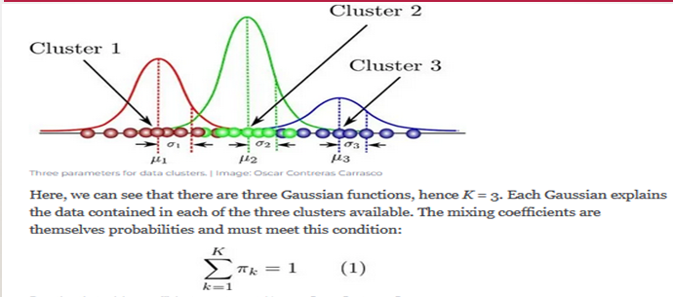
CONTD..

Slide 7
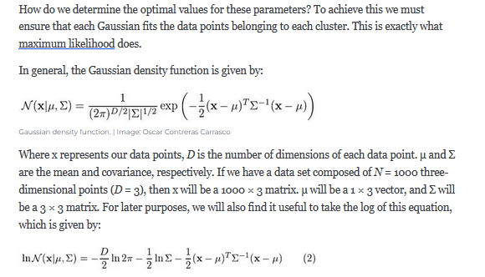
CONTd..

Slide 8
CONTD..
If we differentiate this equation with respect to the mean and covariance and then equate it to zero, then we will be able to find the optimal values for these parameters, and the solutions will correspond to the maximum likelihood estimation (MLE) for this setting.

Slide 9
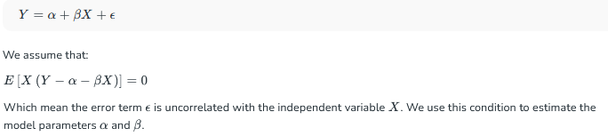
Key Terms in GMM
Moment Conditions: Moment conditions are rules that describe the relationships between the variables
in the model. For example, in a simple linear regression model:

Slide 10
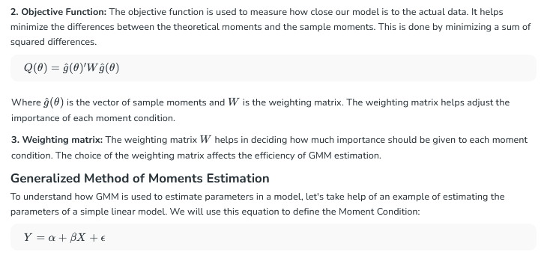
CONTD..

Slide 11
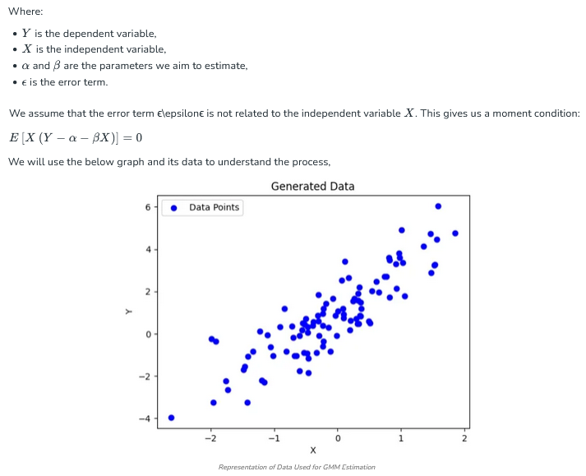
CONTd..

Slide 12
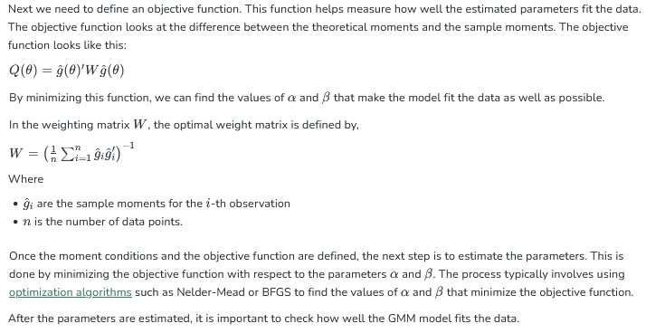
CONTD..

Slide 13
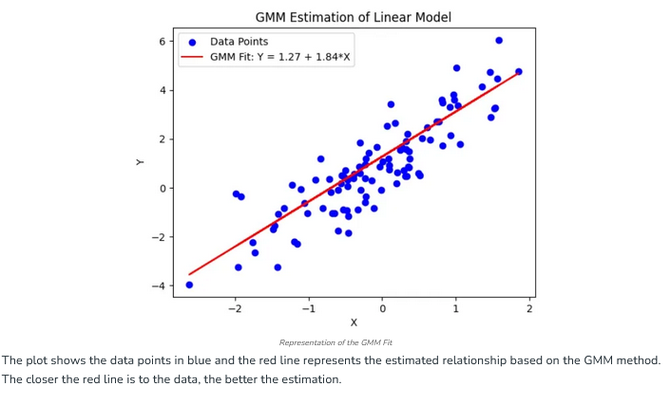
CONTD..

Slide 14
Applications of Generalized Method of Moments
Econometrics & Macroeconomics: GMM is used to estimate parameters in economic models with mutual dependence, such as growth and asset pricing models.
Structural Equation Modeling: It estimates relationships in models with measurement errors and causal inference.
Model Testing: It provides tools like the Hansen J-test for testing the validity of instruments.
Time Series Analysis: It is applied in volatility and autoregressive models to handle autocorrelation.
Panel Data Models: It is used in fixed and random effects models to deal with unobserved heterogeneity.

Slide 15
Advantages of GMM
It doesn’t require strong assumptions about the data. It can handle models where there are more moment conditions than parameters (over-identified models). It works for both linear and nonlinear models. It’s widely used in economics, finance and social sciences for models like regression, instrumental variables and panel data.
Limitations of GMM
Requires Valid Instruments: The method depends on finding valid instruments as invalid or weak instruments can lead to biased estimates.
Sensitive to Model Specification: Incorrectly specified moment conditions can result in biased or inconsistent estimates.
Weighting Matrix Sensitivity: The efficiency of estimates depends on the correct choice of the weighting matrix, which can be difficult to determine.
Limited for Nonlinear Models: GMM becomes less efficient and harder to apply in complex nonlinear models.

Slide 16
Self-Assessment Questions
1. What does a Gaussian Mixture Model (GMM) assume about the data?
All data comes from a single Gaussian distribution
Data is generated from a mixture of several Gaussian distributions
Data is uniformly distributed
Data points are independent of each other
In a GMM, each Gaussian component is characterized by:
Mean only
Covariance only
Mean and covariance
Standard deviation only

Slide 17
TERMINAL QUESTIONS
1.Explain in your own words what a Gaussian Mixture Model (GMM) is and how it differs from k-means clustering.
2.What assumptions does GMM make about the distribution of the data?
3.How does soft clustering in GMM provide more information than hard clustering?

Slide 18
REFERENCES FOR FURTHER LEARNING OF THE SESSION
Books:
1. Christopher M. Bishop, Pattern Recognition and Machine Learning, Springer, 2006
2. Kevin P. Murphy, Machine Learning: A Probabilistic Perspective, MIT Press, 2012
Web references:
Scikit-learn GMM documentation
https://scikit-learn.org/stable/modules/mixture.html
StatQuest: Gaussian Mixture Models (YouTube)
https://www.youtube.com/watch?v=3xS23yUe6vI

Slide 19
THANK YOU
Team – AI &ML

